Slide 1
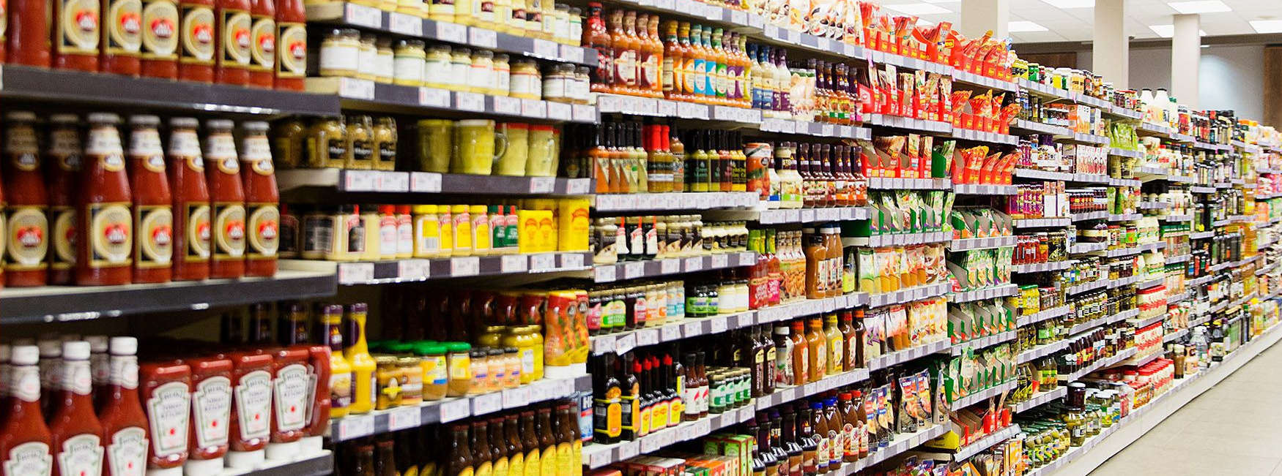
Food deserts’ impact on covid-19 metrics in Chicago
By Manli Patel, Jen Krizman, and Roxanne Meyer

Slide 2
Does grocery store availability impact covid-19 outcomes in Chicago?
While there are many compounding factors as to why specific zip codes had higher Covid-19 infection rates, we wanted to analyze if the amount of grocery stores was correlated to these outcome. We hypothesized that grocery stores, in part, have a positive impact on a zip codes’ health, which has showed to impact a populations’ COVID-19 outcome. Additionally, grocery stores have the ability to administer COVID-19 vaccinations, boosters and tests, which could positively affect a zip codes’ COVID-19 infection rates.

Slide 3
DATA Sources
US Census for Chicago (API)
City of Chicago Data Portal
Grocery Store Status
COVID-19 Hospitalizations and Deaths

Slide 4
Hypothesis 1
Within Chicago Zip Codes, zip codes with higher than average household income will have more grocery stores than zip codes with lower than average household income
Rationale: Businesses are more likely to build in areas where individuals have more disposable income to spend on their products and services

Slide 5
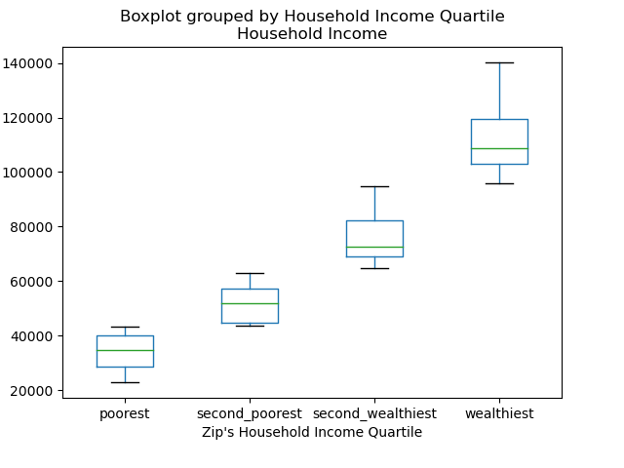
Hypothesis 1 Data
Box Plot
Used bins to put the zip codes in one of 4 bins based on that zip code’s average household income

Slide 6
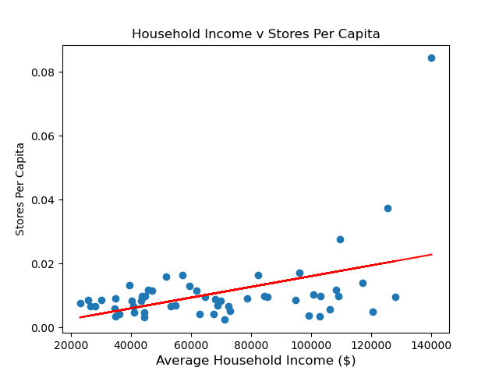
Hypothesis 1 Data(cont.)
Scatter Plot with Regression
The Regression line is modeled by the equation y = 1.679e-07x + -0.0007651913
The r-value is: 0.44475023404704944
The p-value is: 0.0007531819043198361

Slide 7
Hypothesis 2
Within Chicago Zip Codes, lower income areas will have higher rates of COVID-19 than higher income areas
Rationale: Lower Income areas have several contributing factors leading to these higher rates:
Less access to healthcare
Lowered ability to afford healthcare which may mitigate COVID-19 transmission

Slide 8
Hypothesis 2 Data
Double Scatter plot
X: median household income of the zip code
Y: two plots, one for covid 19 hospitalizations, and one for covid 19 deaths
Regression line and r value

Slide 9
Hypothesis 2 Data(cont.)

Slide 10
Hypothesis 3
Within Chicago Zip Codes, another variable which may have affected covid transmission, testing and deaths is education level
Rationale: Those zip codes with lower education levels may not understand the science and therefore have higher levels of distrust of the science. We would expect to see lower testing levels, higher rates of transmission, and therefore higher death rates than zip codes with higher education rates.

Slide 11
Hypothesis 3 Data

Slide 12
Hypothesis 3 Data(cont.)

Slide 13
Conclusions
Hypothesis 1: zips w/ higher average household income will have more grocery stores per capita than zip codes with lower average household income
Hypothesis 2:
Hypothesis 3:

Slide 14
Implications of the analysis

